Slide 1


Protocols

Slide 2

Objectives
At the end of the lesson students should be able to
State what is a network protocol
Describe the difference between network and internet protocol
Describe the TCP/IP
Explain how different protocols work during data transfer

Slide 3
What is Network protocol?
A network protocol is a set of established rules that dictates how to format, transmit and receive data on a network so that two or more devices are able to communicate with and understand each other.
Network protocols are necessary because without a set of rules, computers would not have the capability of "talking" to each other across the Internet.

Slide 4
Protocol Layers
Protocol implementation can be conceptualized as a stack, where each layer serves a specific function in the communication process.
This type of layered approach is fundamental in computer networking and communication process

Slide 5
TCP/IP Protocols
The TCP/IP model, also known as the Internet protocol suite, is a conceptual framework used for understanding and designing network protocols.
It's named after two of its most important protocols:
the Transmission Control Protocol (TCP)
the Internet Protocol (IP).
Developed in the 1970s by the U.S. Department of Defense, it's now the basis for the internet and most local area networks (LANs) worldwide.
The model has four layers:

Slide 6
The Four Layers
Application layer
Transport layer
Internet (Network layer
Link Layer

Slide 7
TCP/IP Protocols
When sending data across the internet (network), the layers are used in the
order layer 4 to layer 1; when receiving data across the internet (network), the
layers are used in the order layer 1 to layer 4.
Each of the layers is implemented using software.

Slide 8
APPLICATION LAYER
The application layer contains all the programs that exchange data, such as web browsing or server software; file transfer, email, remote login ect.
It sends files to the transport layer.
This layer allows applications to access the services used in other layers
It also defines the protocols that any app uses to allow the exchange of data.
There are several protocols associated with the application layer

Slide 9
Protocols-Application Layer
HTTP hypertext transfer protocol; this is a protocol responsible for correct transfer of files that make up web pages on the world wide web
SMTP simple mail transfer protocol; this handles the sending of emails
POP3/4 post office protocol; this handles the receiving of emails
IMAP internet message access protocol; this handles the receiving of emails
DNS domain name service; protocol used to find the IP address, for example, when sending emails
FTP file transfer protocol; this is a protocol used when transferring messages and attachments
RIP routing information protocol; this is the protocol routers use to exchange routing information over an IP network
SNMP simple network management protocol; protocol used when exchanging network management information between network management and network devices (such as routers, servers and other network devices)

Slide 10
TRANSPORT LAYER
Its primary function takes in the establishment, maintenance, and termination of connections between devices, ensuring the steadfast delivery of data from source to destination.
The transport layer regulates the network connections; this is where data is
broken up into packets which are then sent to the internet/network layer (IP
protocol). The transport layer ensures that packets arrive in sequence, without
errors, by swapping acknowledgements and retransmitting packets if they
become lost or corrupted

Slide 11
TRANSPORT LAYER
The main protocols associated with the transport layer are Transmission Control Protocol (TCP), user datagram protocol (UDP) and SCTP.
Transmission control protocol (TCP)
TCP is responsible for the safe delivery of a message by creating sufficient packets for transmission.
It uses positive acknowledgement with retransmission (PAR) which means it automatically re-sends a data packet if it has not received a positive acknowledgement.
TCP is also connection-orientated since it establishes an end-to-end connection between two host computers using handshakes. For this last reason, TCP is often referred to as a host-to-host transmission protocol.
What is an handshake?

Slide 12


Two Transport Protocols

Slide 13
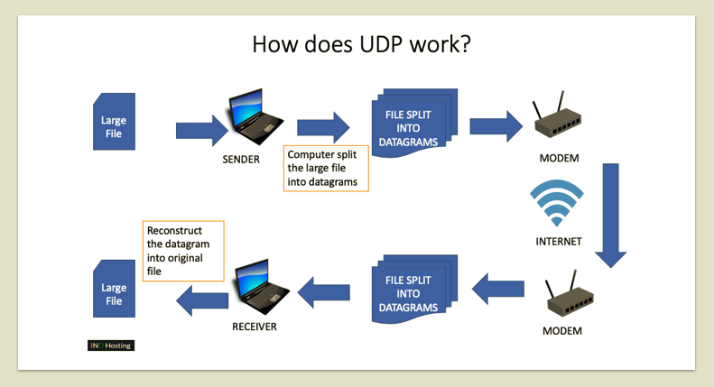
UDP/IP
The User Datagram Protocol, or UDP, is another widely used transport protocol.
It's faster than TCP, but it is also less reliable.
UDP does not make sure all packets are delivered and in order, and it doesn't establish a connection before beginning or receiving transmissions.
Datagram is an alternative term for "packet.

Slide 14
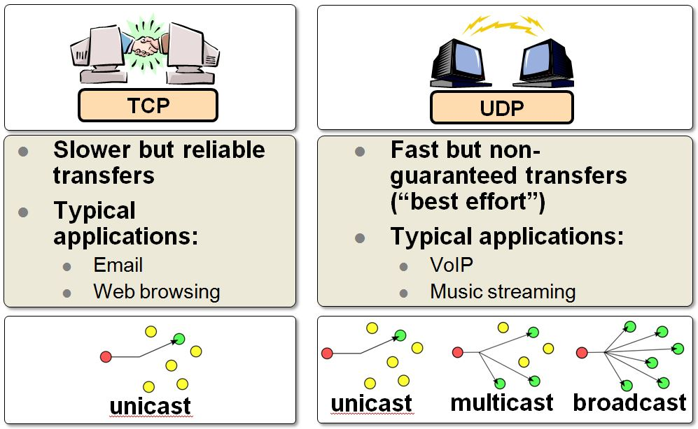
Comparison

Slide 15
TRANSPORT LAYER OPERATION
The re are two computers communicating e.g. the host X communicates with another host “Y”
Host ‘X’ will first of all send host ‘Y’ a segment (packet) which will include synchronisation sequence bits so that segments will be received in the correct order.
Host ‘Y’ will now respond by sending back its own segment (containing an acknowledgement together with its own synchronisation sequence bits).
Host ‘X’ now sends out its own acknowledgement that the segment from ‘Y’ was received.
Transmission of data between ‘X’ and ‘Y’ can now take place.

Slide 16
INTERNET/NETWORK LAYER
The internet layer identifies the intended network and host.
The common protocol is IP (internet protocol) used for routing packets across different networks in the TCP/IP model .
Pv4 (Internet Protocol version 4) and IPv6 (Internet Protocol version 6) are the two main versions of IP in use today.
It uses the internet Control Message Protocol (ICMP): This protocol is used for error reporting and diagnostics. It's often used for functions like ping and traceroute.

Slide 17
INTERNET/NETWORK LAYER
The Internet Layer is crucial for enabling communication between different networks, which may have different physical and data-link layer technologies. It ensures that packets are properly addressed and routed to their destination.
This is a summary of the IP functions:
Ensure correct routing of packets of data over the internet/network.
Responsible for protocols when communicating between networks.
Take a packet from the transport layer and add its own header which will include the IP addresses of both sender and recipient.
The IP packet (datagram) is sent to the data-link layer where it is assembles the datagrams into frames for transmission.

Slide 18
DATA LINK LAYER
Data-link layer
identifies and moves traffic across local segments
divides IP packets into frames (packets) for transmission
maps IP addresses to MAC (physical) addresses
ensures correct protocols are followed.
The physical network layer specifies requirements of the hardware to be used for the network.
The data-link layer identifies network protocols in the packet header (TCP/IP in the case here) and delivers packets to the network.

Slide 19
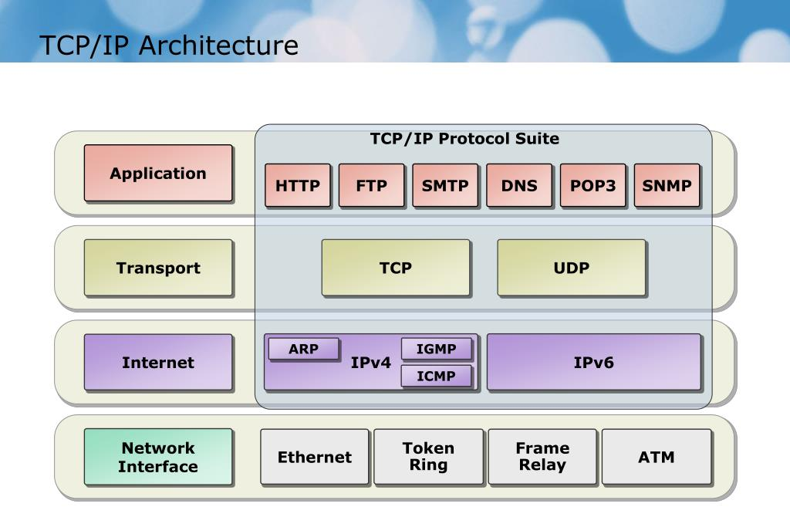
TCP/IP

Slide 20


Student’s Activity
Research on one of the following
IMAP
FTP
HTTP
HTTPS
SSL
SMTP
Bit Torrent

Slide 21

Students’ Presentation

Slide 22

Teacher Review

Slide 23
BIT TORRENT
BitTorrent is a peer-to-peer file sharing protocol.
It enables users to distribute data across a network of peers (other users) instead of relying on a central server.
This makes it efficient for large file distribution.
The peer-to-peer networks only work well with very small numbers of computers, the concept of sharing files using BitTorrent can be used by thousands of users who connect together over the internet.
User computers are sharing files directly with each other (rather than using a web server) similar to file sharing in a peer-to-peer network; the main difference is that the BitTorrent protocol allows many computers (acting as peers) to share files

Slide 24
TERMS USED WHEN USING BITTORRENT
Swarm – a group of peers connected together is known as a swarm; one of the most important facts when considering whether or not a swarm can continue to allow peers to complete a torrent is its availability; availability refers to the number of complete copies of torrent contents that are distributed amongst a swarm. Note: a torrent is simply the name given to a file being shared on the peer-to-peer network.
Seed – a peer that has downloaded a file (or pieces of a file) and has then made it available to other peers in the swarm.
Tracker – this is a central server that stores details about other computers that make up the swarm; it will store details about all the peers downloading or uploading the file, allowing the peers to locate each other using the stored IP addresses.

Slide 25

TERMS USED WHEN USING BITTORRENT
Leech – a peer that has a negative impact on the swarm by having a poor share ratio, that is, they are downloading much more data than they are uploading to the others; the ratio is determined using the formula:
If the ratio > 1 then the peer has a positive impact on the swarm; if the ratio < 1 then the peer has a negative effect on the swarm
Lurker – a peer that downloads many files but does not make available any new content for the community as a whole.

Slide 26
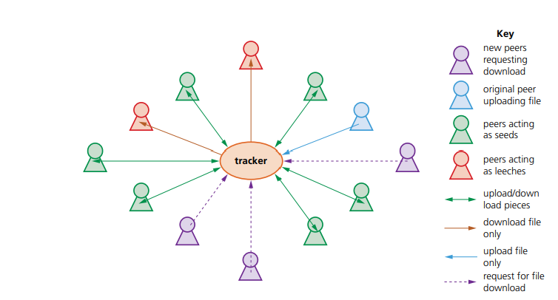
Example –Bit torrent operation
There are12 peers have connected to the tracker. One peer has begun to upload a video file and six peers are acting as seeds. Two peers are behaving as leeches and three peers have just joined and have requested a download of the video file. The arrangement would look something like this:

Slide 27
Non-Secure Protocol

Slide 28
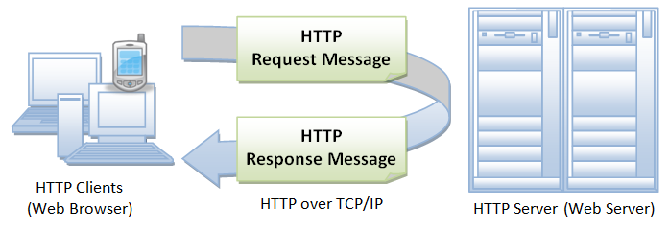
HTTP-HyperText Transfer Protocol.
This protocol is used for delivering data (usually HTML files, multimedia files, etc.) on the World Wide Web through its default TCP port 80.
It works at the application layer and used primarily with the WWW (World Wide Web) in the client-server model where a web browser is a client communicating with the webserver which is hosting the website.

Slide 29
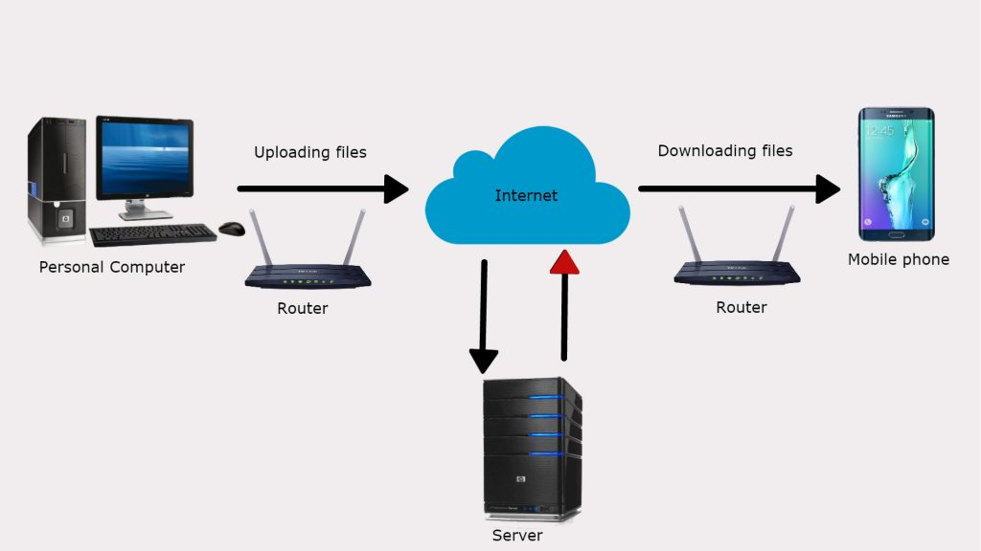
FTP-File Transfer Protocol
FTP (File Transfer Protocol) is used to communicate and transfer files between computers on a TCP/IP (Transmission Control Protocol/Internet Protocol) network, aka the internet. Users, who have been granted access, can receive and transfer files in the File Transfer Protocol server (also known as FTP host/site).

Slide 30
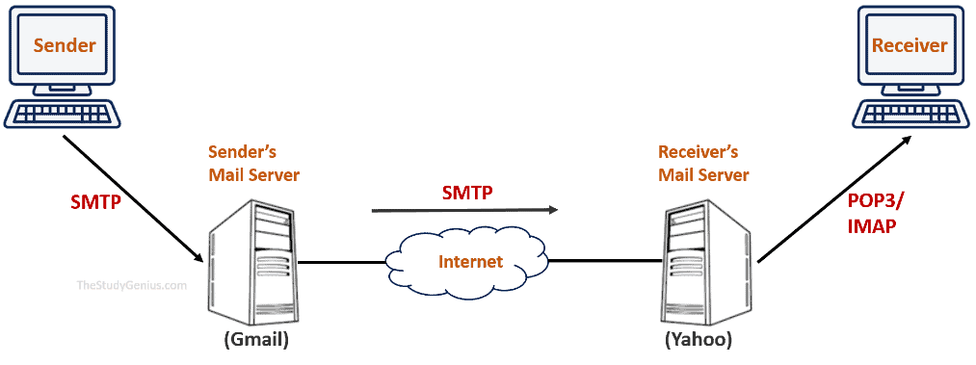
SMTP-Simple Mail Transfer Protocol,
SMPT is a simple network protocol that allows us to transfer the email to the email server using some commands
It is a set of commands used to only send emails over the internet.
Whenever you send an email, you’re using simple mail transfer protocol (SMTP) commands
SMTP is used by the client to send email to the server.
When sending an email, SMTP is used twice
1st between the sender and the sender’s mail server
2nd between the sender’s mail server and the receiver's mail service

Slide 31
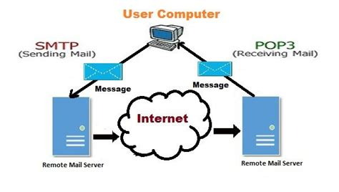
POP3 (Post Office Protocol version 3)
(POP3) is an Internet standard mail protocol used to receive emails from a remote server to a local email client, that works on the application layer. It is used by local email software to retrieve emails from a remote mail server over a TCP/IP connection
Incoming messages are stored at the POP server until the user logs in using an email client and downloads the messages to their computer. After the user downloads the message, it is deleted from the server.
POP3 allows you to download email messages on your local computer and read them even when you are offline.

Slide 32
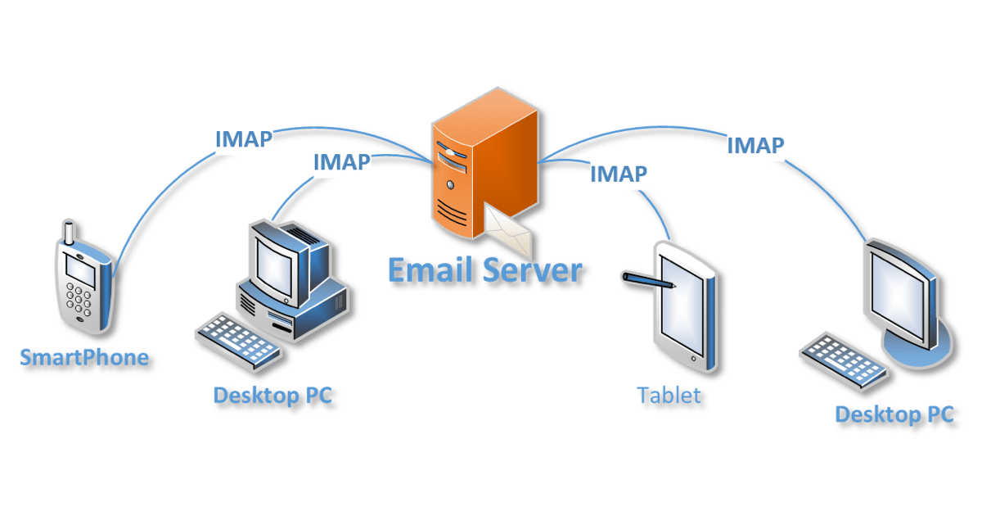
IMAP is a protocol is a standard protocol for accessing email on a remote server. It works on the application layer. It is used to retrieve and store email through an email server via the TCP/IP connection. IMAP allows you to access your email wherever you are, from any device. When you read an email message using IMAP, you aren't actually downloading or storing it on your computer; instead, you're reading it from the email service
IMAP (Internet Message Access Protocol)

Slide 33
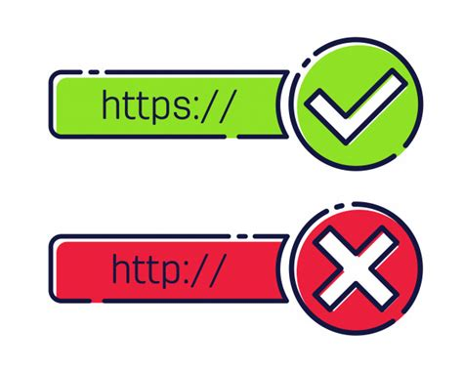
SECURE PROTOCOL

Slide 34
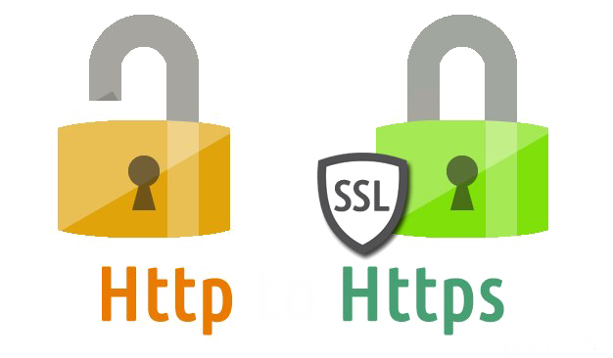
HTTPS- Hyper Text Transfer Protocol Secure
Hypertext transfer protocol secure (HTTPS) is the secure version of HTTP, which is the primary protocol used to send data between a web browser and a website. HTTPS is encrypted in order to increase security of data transfer. This is particularly important when users transmit sensitive data, such as by logging into a bank account, email service, or health insurance provider.
HTTPS uses an encryption protocol to encrypt communications. The protocol is called Transport Layer Security (TLS), although formerly it was known as Secure Sockets Layer (SSL).
This protocol secures communications by using the asymmetric public key infrastructure.

Slide 35
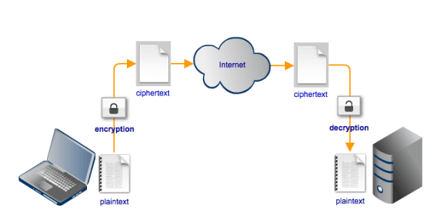
SFTP Secure File Transfer Protocol
SFTP provides a secure connection to transfer files and traverse the file system on both the local and remote system.
SFTP is also named SSH FTP. SSH is for a secure connection, and FTP is for file transfer protocol. The two protocols work together to transfer a file securely between two connected computers over an underlying TCP/IP network.
SFTP also protects against password sniffing and man-in-the-middle attacks.
It protects the integrity of the data using encryption and cryptographic hash functions and authenticates both the server and the user.

Slide 36
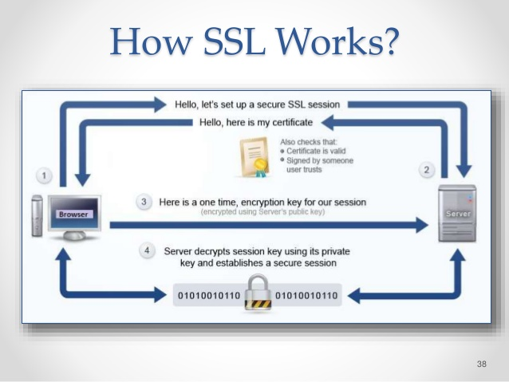
SSL Secure Socket Layer
SSL allows security by allowing applications to encrypt data that go from a client to a matching server
Secure Sockets Layer (SSL) was the most widely deployed cryptographic protocol to provide security over internet communications before it was preceded by TLS (Transport Layer Security)

